Slide 1
Billboard Hot 100
Cedric Sissom NSS DA9
Notes:
Since music is something I am passionate about, I wanted to see if I could somehow get a better understanding of how these charts work. I've spen a lot of time touring with bands so I have always had a

Slide 2
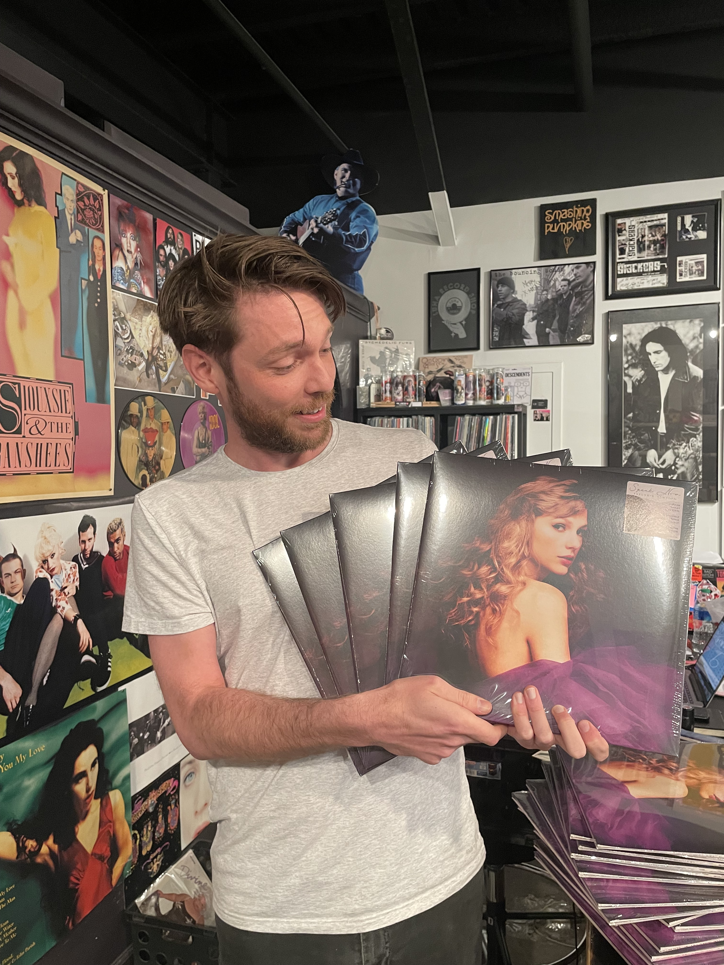

Slide 3
AGENDA
Data Question
Data Explanation
Data Sets
1958-1967
2012-2021
Conclusion
Notes:
Agenda:Data Question Introduction: We'll start by framing the central data question that drives my analysis.Scratching the Surface: We'll briefly explore the initial data overview and context, try to set the stage for more in-depth analysis. Decades in Focus: We'll dive into two key decades, 1958-1967 and 2012-2021, examining significant trends and changes .Reporting Findings: Finally, we'll present and discuss the key findings and insights from our data analysis.

Slide 4
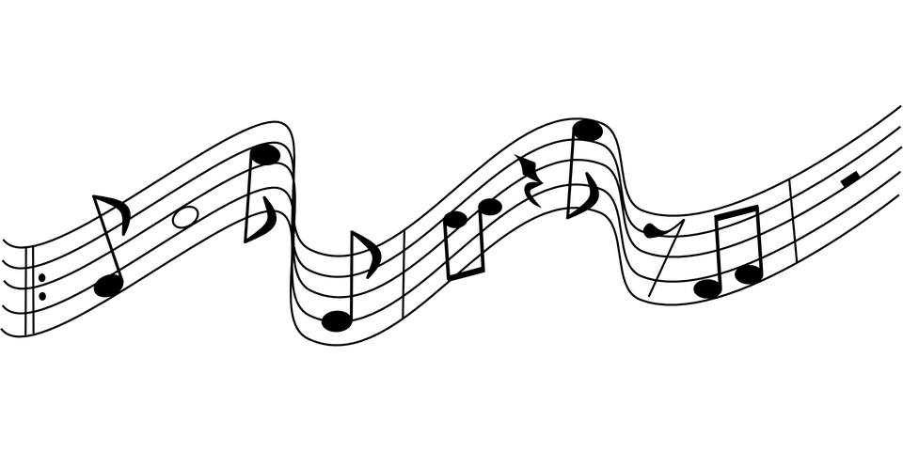
Data Question: How have music sentiment, genre trends, and tempo in Billboard-charting songs evolved over the past six decades?

Slide 5
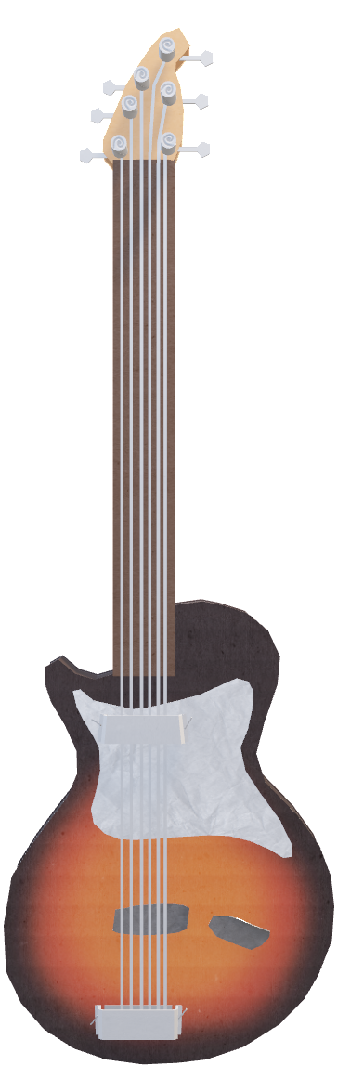
How can music popularity be quantified by data?
POPULARITY:
Reach: The number of people exposed to the music
Influence: Measures the reaction of those exposed to the content.
Access: The ability of the artist to access those fans directly.
But are there any platforms that compile all this information?

Slide 6
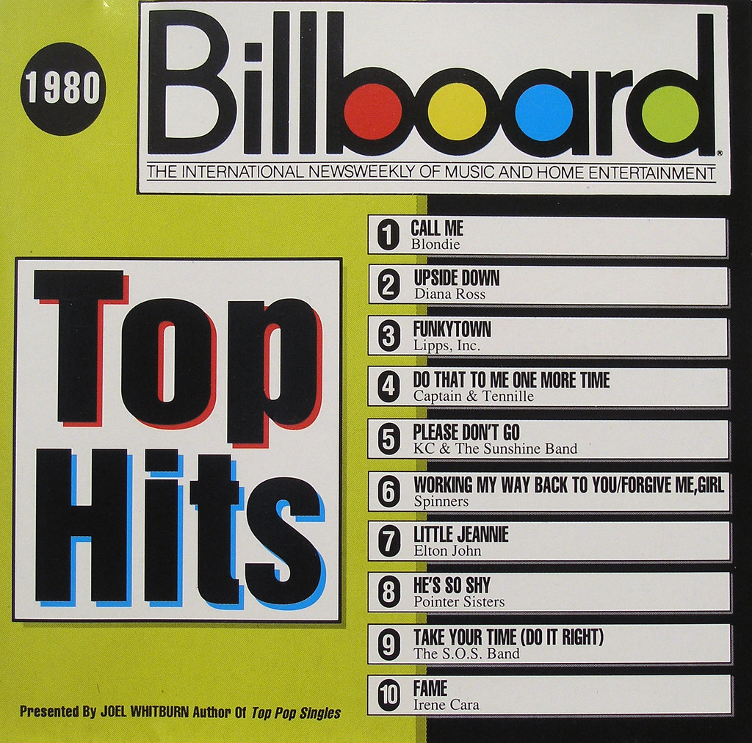
Measuring popularity
Over the years, the methods used to track and measure popular music have certainly transformed with the innovation of streaming.
Despite rapid changes to the industry, one ranking system has remained tried and true for over 50 years, and that is the Billboard Top 100 chart. For that purpose, we will be utilizing data sets pulled from their weekly record database.
This Photo by Unknown Author is licensed under CC BY

Slide 7
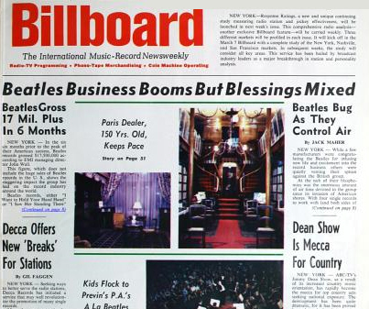
What is the Billboard hot 100 and why is it relevant?
The Billboard Hot 100 chart made its debut on August 4th, 1958
Chart rankings are based on sales (physical and digital), online streaming, and radio play in the U.S.
The main purpose of the Hot 100 is to aid those within the music industry: to reflect the popularity of the "product" (the singles, the albums, etc.)
This Photo by Unknown Author is licensed under CC BY-NC-ND

Slide 8
How have music sentiment, genre trends, and tempo in Billboard-charting songs evolved over the past six decades?
So…
THE DATA SOURCE
Billboard Hot 100 chart data from the 1958-1967 and 2012-2021
Spotify API
Sentiment analysis program to analyze lyrics
Genius Lyrics API.
Important note: We are comparing the first 10 years of its existence and to the most recent decade to try to get a better sense of just how drastic the changes have been.

Slide 9
The comparison
Sentiment: The emotional tone or attitude expressed in a piece of text.
Genre: A category or classification that is used to group and categorize creative works
Tempo: the speed or pace at which a musical composition is performed or the rate at which musical beats or pulses are played or felt
Notes:
There are 3 major things I will be looking at to make this comparisson: Sentiment, Genre and Tempo. Up next I will dive a little further into these concepts

Slide 10



Sentiment
Highly positive score will be closer to 1.
Score of 0
Score of -1
Positive
Neutral
Negative
Notes:
-TextBlob is a Python library for processing textual data. It provides a simple API for diving into common natural language processing (NLP) tasks such as part-of-speech tagging, noun phrase extraction, sentiment analysis, classification, translation, and more.
-In addition to classifying the text as positive, negative, or neutral, TextBlob provides a sentiment score. This score is a numeric value that quantifies the strength of the sentiment. For example, a highly positive sentence might have a sentiment score close to +1, while a strongly negative sentence might have a sentiment score close to -1. Neutral sentences will have scores close to 0.

Slide 11
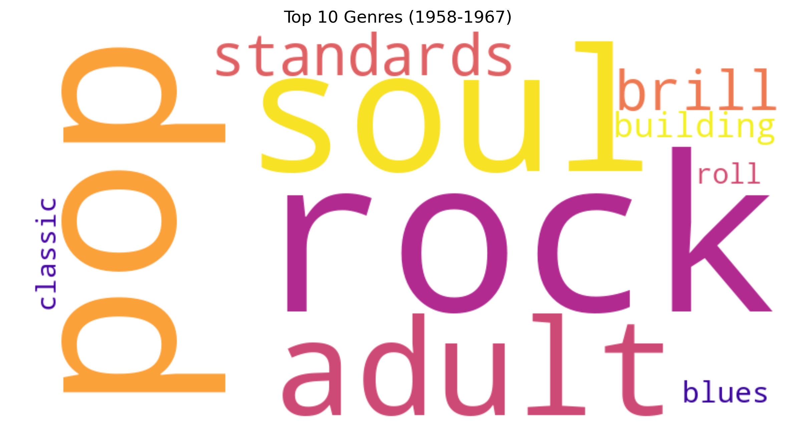
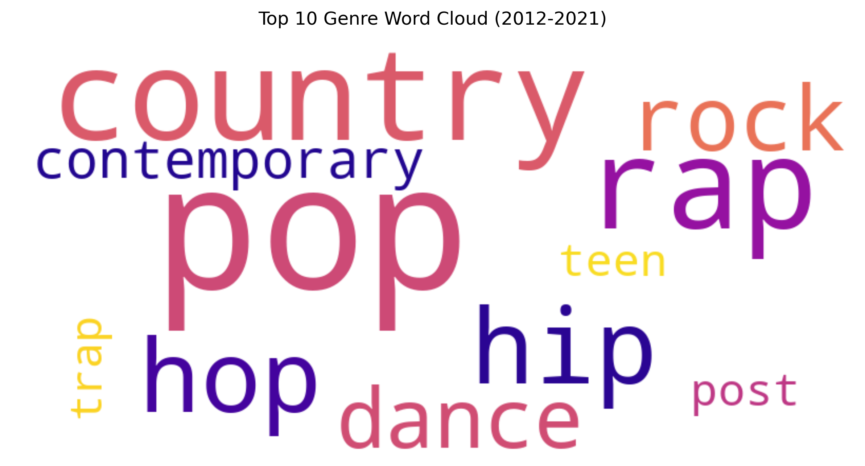
Genre
Notes:
Music genres are categories or classifications used to group and describe music based on certain shared characteristics, styles, or elements.

Slide 12
tempo/BPM
25-76
SLOW
77-120
MEDUM
121-200
FAST
Notes:
Using Spotifys API, I was able to collect the tempo for each song.

Slide 13
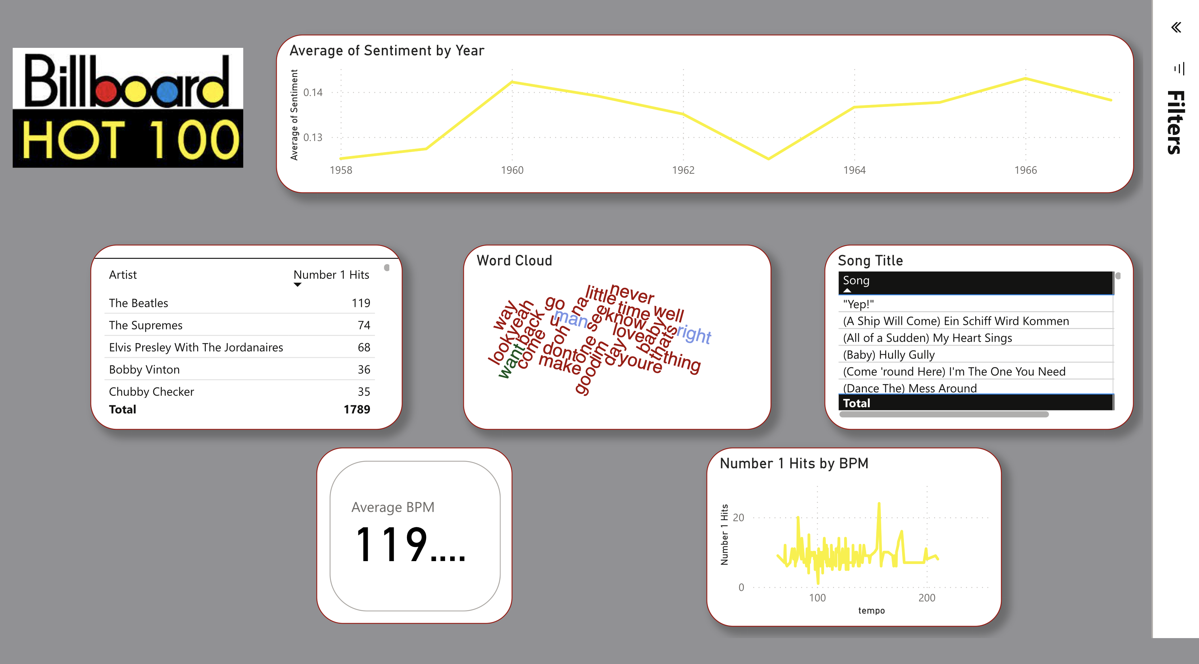
1958-1967
Notes:
-first chart shows the artists who achieved the #1 slot and how many times they did.
-track listing
-average BPM 119.15: that will fall in the medium tempo range
-word cloud shows most commonly used words and usage number – Ive highlight the most used word- “Love” 7,623
-average sentiment: the 50s and 60s were a pretty positive time for music. While there are some dips in the average, the general sentiment never dips below positve.

Slide 14
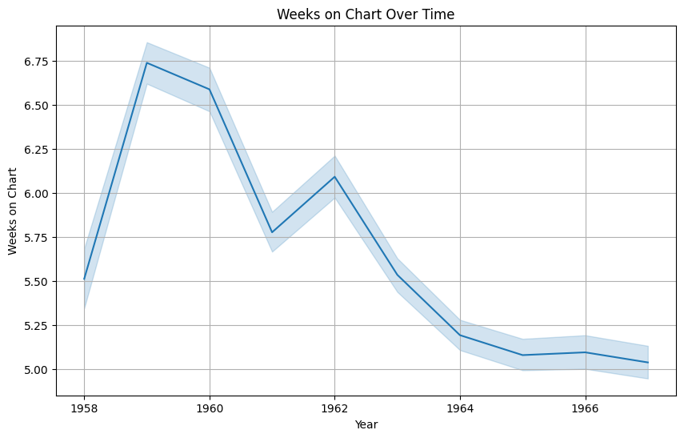
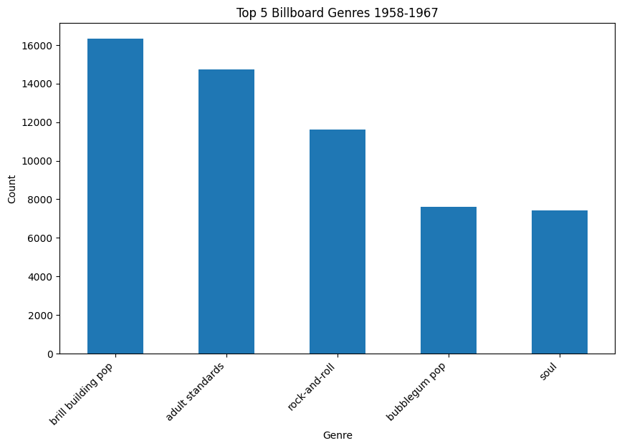
1958-1967
Notes:
-Weeks on chart overtime: what is the average amount of time songs would stay on the chart? In this decade, on average: songs would typically stick around for a 5 to 6 week period.
-The most popular genre from this decade was Brill building Pop: subgenre of pop music that took its name from the Brill Building in New York City, where numerous teams of professional songwriters penned material for girl groups and teen idols during the early 1960s

Slide 15
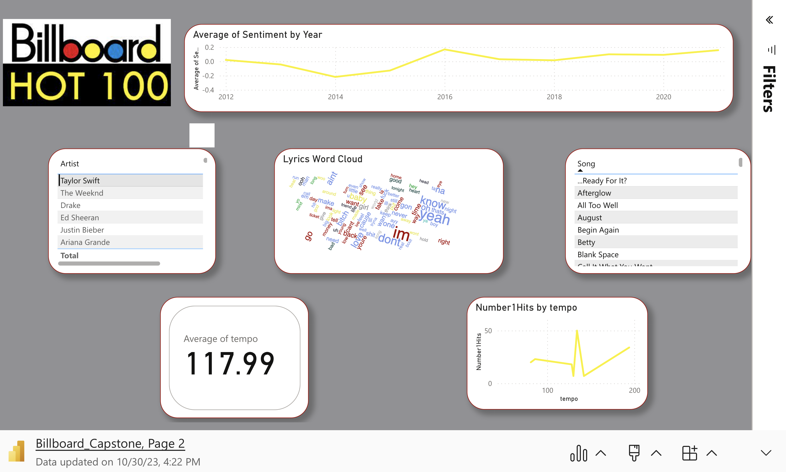
THANK YOU
2012-2021
Mirjam Nilsson
mirjam@contoso.com
www.contoso.com
Notes:
-AVG tempo: 122.56-This would fall in the fast tempo range. Listeners in the 2010-20s enjoy a little faster paced music.
Word cloud – “yeah” 11,295
-Sentiment still remains positive over time, but bits much closer to the negative/neutral territory.

Slide 16
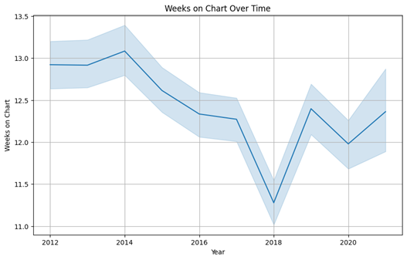
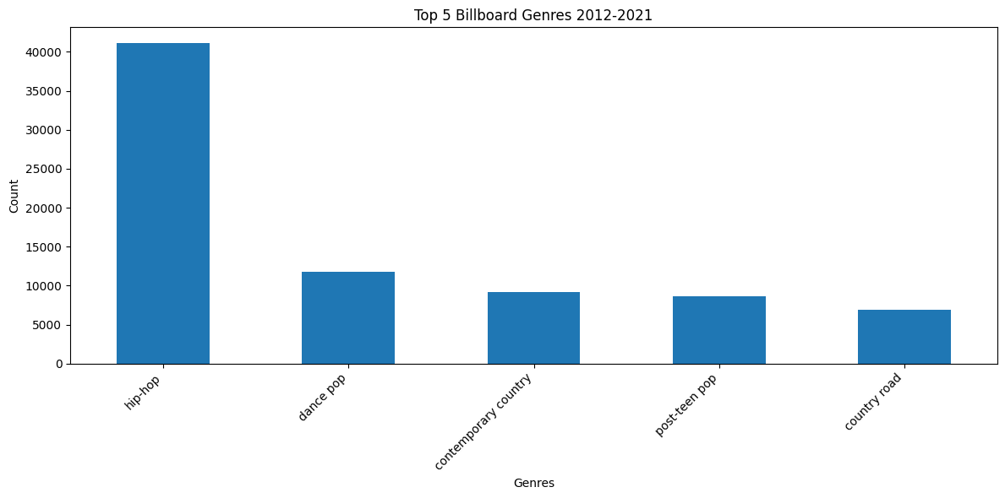
2012-2021
Notes:
Avg amount of time spent on charts increased tremendously during this decade with the average placement being over 10 weeks and getting as high as 13.
Hip hop takes the top spot in the genre territory.

Slide 17
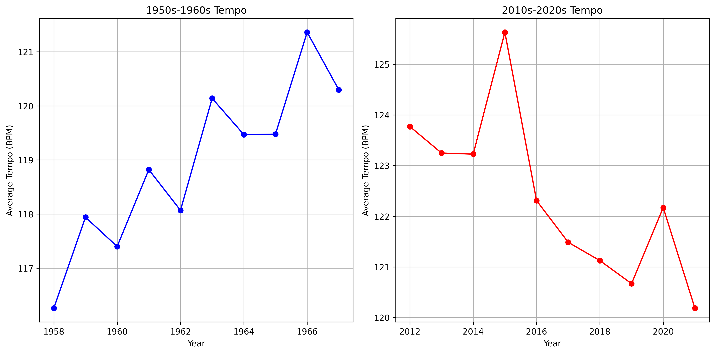
Conclusion
Notes:
Tempo comparison between decades.
1950s-1960s: Music listeners generally liked a more mid-tempo song. Most charting songs were right in the middle of that slow/medium tempo pocket while listeners in the 10s-20s were into a little more fast paced material.

Slide 18
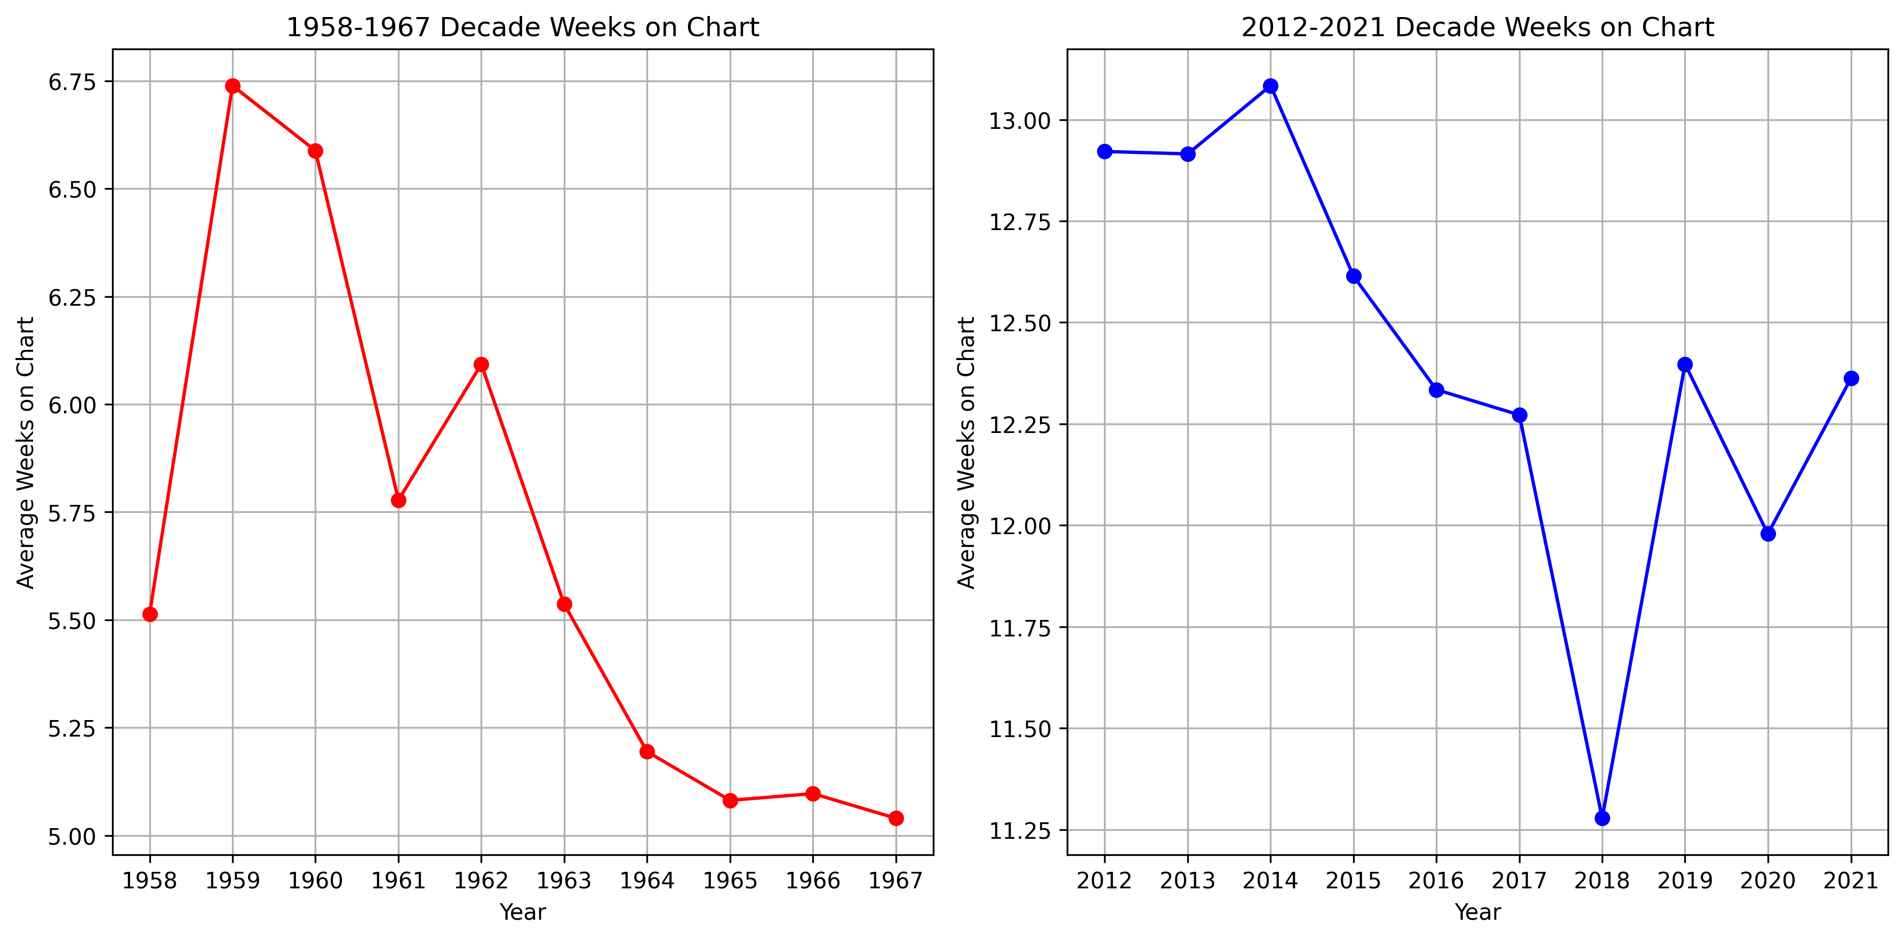
Notes:
Songs would stay on the charts for a little over a month in the 50s and 60s while in the 10-20s songs could stick around for upwards of 3 months.

Slide 19
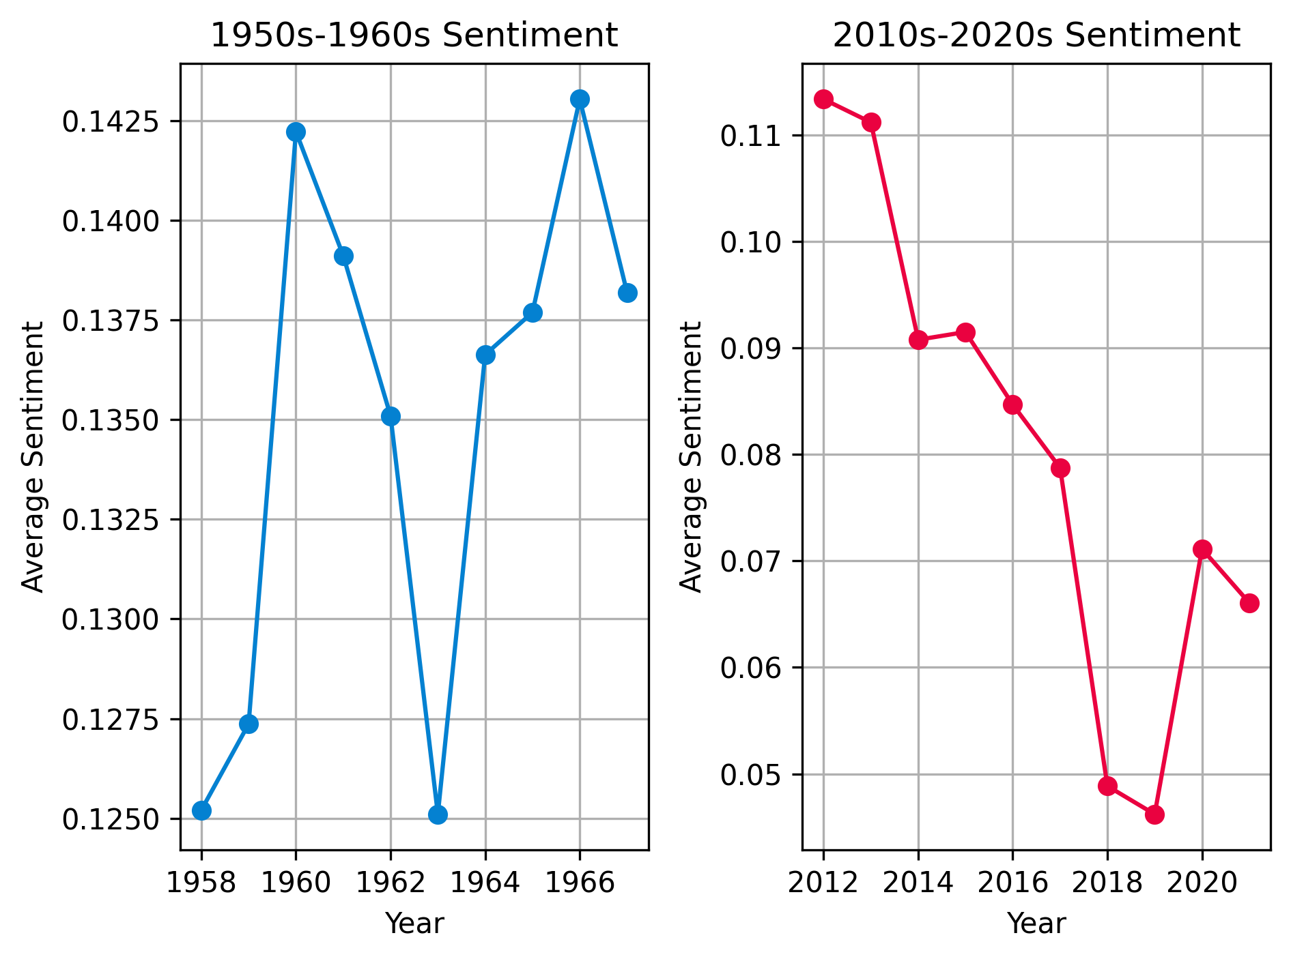
conclusion
Notes:
While songs from both decades were relatively positive, the 50s and 60s win that comparison. The sentiment started high in the 50s and only got higher as time went on
while the next decade started strong in 2012 but dropped significantly as time went on.

